Slide 1
Isolation Forest
Hanse Kim

Slide 2
Anomaly Detection
Finding the ‘anomaly‘ from a group
Well developed field with numerous examples;
Mostly distance-based, constructs profile of normal examples
Examples : k-NN, LOF

Slide 3
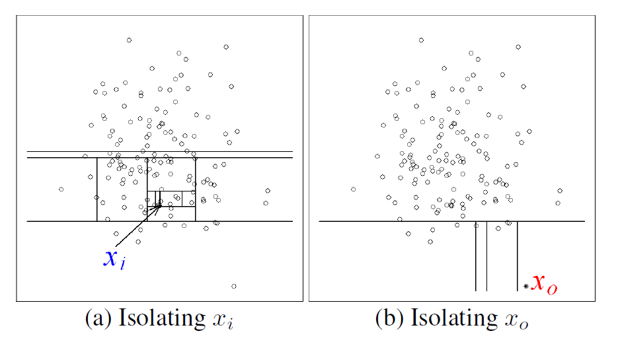
Isolation Forest
Isolation forest focuses on explicitly isolating anomalies
Utilising ‘few and different’ characteristic
Leads to susceptibility to isolation; recursive decision trees to partition

Slide 4
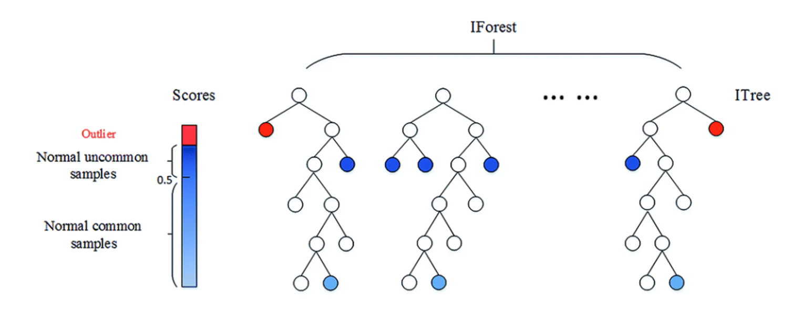
Isolation Forest
Isolation forest focuses on explicitly isolating anomalies
Utilising ‘few and different’ characteristic
Leads to susceptibility to isolation; recursive decision trees to partition

Slide 5
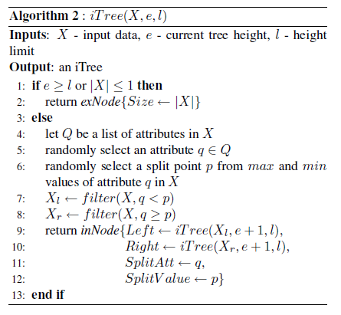
Training Stage : Isolation Tree
Binary decision tree
External node with no child; representing ‘group’ of data
Internal node with one test and two daughter nodes; representing ‘split’ of data
‘Split’ defined randomly
Recursive partition until;
‘Group’ of data to be split has one element
Height limit reached

Slide 6
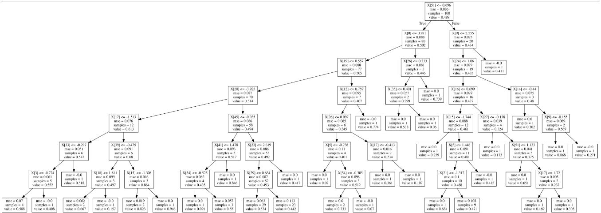
Training Stage : Isolation Tree
Expect anomalies to have shorter path length

Slide 7
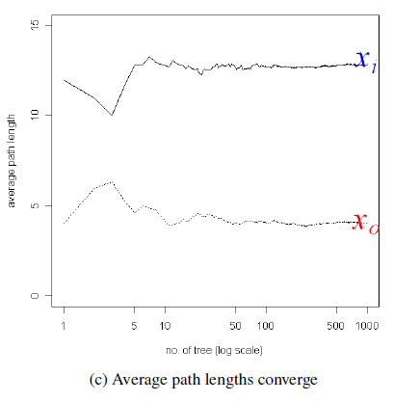
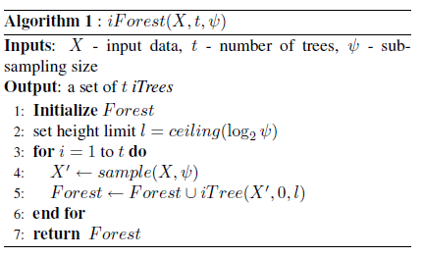
Training Stage : Isolation Forest
Ensemble of isolation trees
Multiple trees acting as ‘experts’ for different anomalies
Around 50 trees gives converging path length

Slide 8
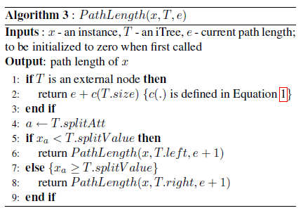

Evaluation Stage : Anomaly Score
After initial phase of constructing isolation forest using dataset, anomaly score is calculated for each data point individually
Calculate path length for each tree, expected value over entire forest
Normalise with average path length of BST; ≈ 2log(n)

Slide 9
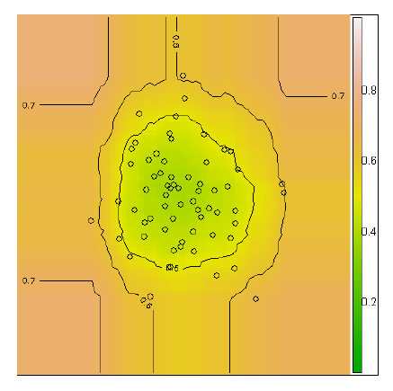
Evaluation Stage : Anomaly Score
Obtain visual representation by passing through a lattice sample
Higher score represents greater likelihood to be anomaly

Slide 10
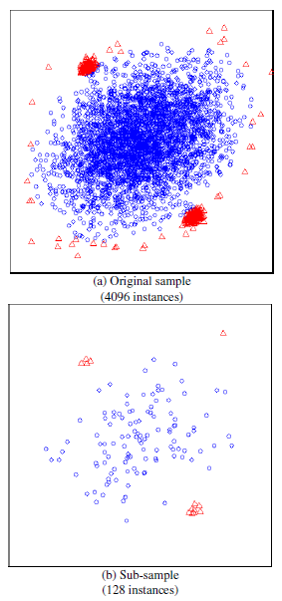
Characteristics of Isolation Forests
Works best when sampling size is kept small
Large sampling prevents isolation as normal instances can interfere
Sub-sampling conducted
Paper provides data on optimal sub-sample sizes; only a fraction of data required

Slide 11
Characteristics of Isolation Forests
Especially prevents problems in anomaly detection
Swamping : normal data instances too close to anomalous data being wrongly identified
Masking : too many anomalies grouped together appearing as normal
Lower data size helps isolation
Each sub-sample includes different sets of anomalies, or none at all

Slide 12
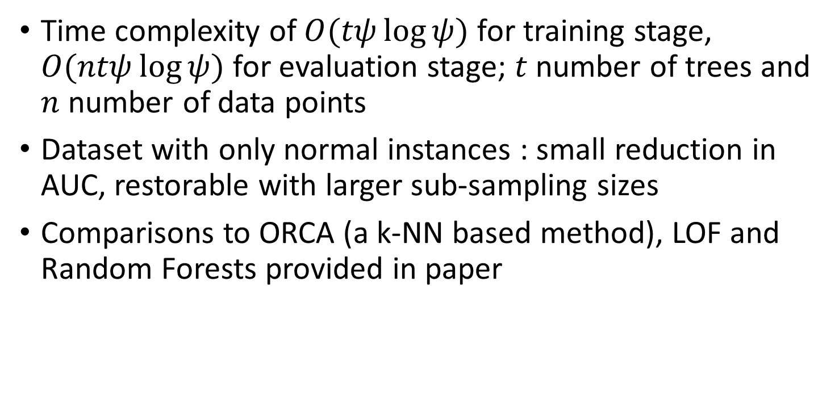
Further Analysis
Time complexity of $O(tψ\log{ψ)}$ for training stage, $O(ntψ\log{ψ})$ for evaluation stage; $t$ number of trees and $n$ number of data points
Dataset with only normal instances : small reduction in AUC, restorable with larger sub-sampling sizes
Comparisons to ORCA (a k-NN based method), LOF and Random Forests provided in paper

Slide 13
References
Paper : Isolation Forest, Liu et al.
Youtube : 03-7: Anomaly Detection - Isolation Forest (이상치탐지 - Isolation Forest)
https://www.youtube.com/watch?v=puVdwi5PjVA
Isolation Forest (for anomaly detection)
https://dodonam.tistory.com/129

Slide 14
Thank you for listening

